Slide 1
ETL
Extraction-Transformation-Load

Slide 2
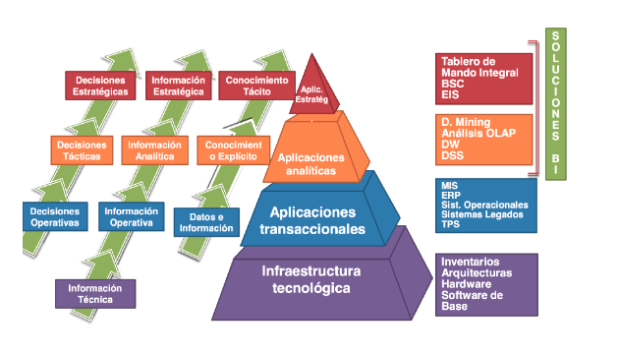

Slide 3
The mission of a Data Warehousing
Un Data Warehouse es un sistema que extrae, limpia, conforma y entrega datos de origen en un almacén de datos dimensional y luego apoya e implementa consultas y análisis con el propósito de tomar decisiones.
Repaso
Notes:
Data warehousing is the process of taking data from legacy and transaction database systems and transforming it into organized information in a user-friendly format to encourage data analysis and support fact-based business decision making.
we have consistently defined a data mart as a process-oriented subset of the overall organization's data based on a foundation of atomic data, and that depends only on the physics of the data-measurement events, not on the anticipated user's questions.
En base a Bill Inmon, el ODS (Operational Data Store) es un tipo de repositorio intermedio que almacene los datos más recientes y que actualice en near-real time.
Se utiliza para decisiones más tacticas.
Características:
Subject Oriented
Integrated
Volatile
Current Data
Detailed Data (Datos a Nivel atomico)
3FN / Ligeramente Normalizado (Tablas combinadas que posean las mismas claves)
Un Data Warehouse es una colección de datos usada para soportar el proceso de toma de decisiones estratégicas de una organización. Es el punto central de integración de datos para BI. El DW es a nivel de toda la organización, en cambio los DATAMARTS son a nivel de los departamentos, ya que estos presentan datos específicos que le interesan al departamento.

Slide 4
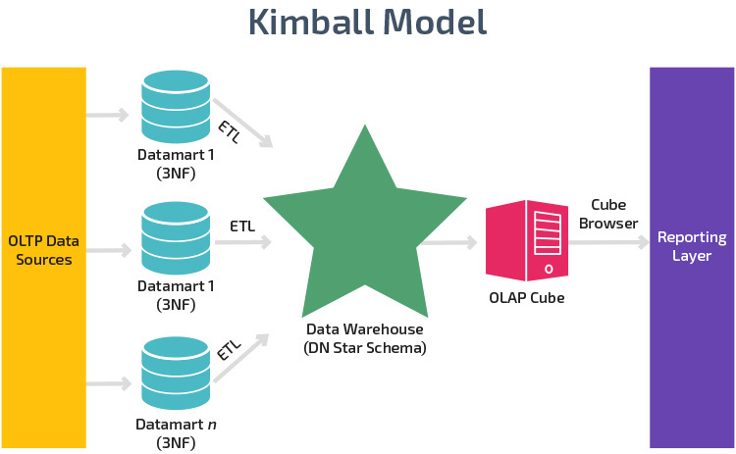
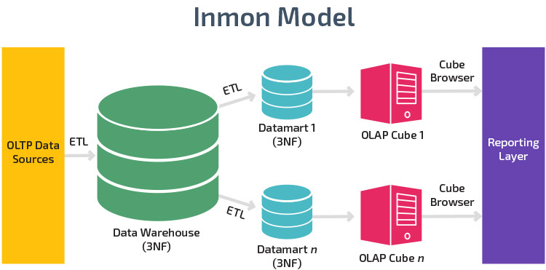
Data mart vs Data Warehouse
Repaso
Notes:
A data mart is a subset of a data warehouse oriented to a specific business line. Data marts contain repositories of summarized data collected for analysis on a specific section or unit within an organization, for example, the sales department.
Data Mart
Focus: A single subject or functional organization area
Data Sources: Relatively few sources linked to one line of business
Size: Less than 100 GB
Normalization: No preference between a normalized and denormalized structure
Decision Types: Tactical decisions pertaining to particular business lines and ways of doing things
Cost: Typically from $10,000 upwards
Setup Time: 3-6 months
Data Held: Typically summarized data
Data Warehouse
Focus: Enterprise-wide repository of disparate data sources
Data Sources: Many external and internal sources from different areas of an organization
Size: 100 GB minimum but often in the range of terabytes for large organizations
Normalization: Modern warehouses are mostly denormalized for quicker data querying and read performance
Decision Types: Strategic decisions that affect the entire enterprise
Cost: Varies but often greater than $100,000; for cloud solutions costs can be dramatically lower as organizations pay per use
Setup Time: At least a year for on-premise warehouses; cloud data warehouses are much quicker to set up
Data Held: Raw data, metadata, and summary data

Slide 5

KIMBALL + INMON

Slide 6
ETL
ETL representa las bases de un Data Warehouse.
Un sistema de ETL recolecta información de diferentes sistemas transaccionales, refuerza la calidad y consistencia de datos, y los almacena para que puedan ser consumidos por analistas y desarrolladores desde un repositorio centralizado
Notes:
The Extract-Transform-Load (ETL) system is the foundation of the data warehouse. A properly designed ETL system extracts data from the source systems, enforces data quality and consistency standards, conforms data so that separate sources can be used together, and finally delivers data in a presentation-ready format so that application developers can build applications and end users can make decisions. This book is organized around these four steps.

Slide 7
Características
Remueve errores y corrige datos faltantes
Provee métricas documentadas de confianza en los datos
Captura el flujo de datos transaccionales para resguardo
Ajusta los datos de múltiples fuentes para ser usados en conjunto
Estructura los datos para poder ser utilizados por usuarios finales, analistas y desarrolladores.
Notes:
The ETL system adds significant value to data. It is far more than plumbing for getting data out of source systems and into the data warehouse. Specifically, the ETL system:
Removes mistakes and corrects missing data
Provides documented measures of confidence in data
Captures the flow of transactional data for safekeeping
Adjusts data from multiple sources to be used together
Structures data to be usable by end-user tools

Slide 8
ETL o ELT?

Slide 9
Definición de ETL y ELT
ETL: Extract, Transform, Load
Definición de Extractores de los sistemas fuentes
Procesamiento intensivo de transformaciones y revisiones de integridad o calidad en una herramienta o servidor intermedio
Carga en el Modelo o Destino final (DW o DM)
ELT: Extract, Load, Transform
Definición de Extractores de los sistemas fuentes
Carga en el Destino intermedio (landing zone o staging area)
Procesamiento intensivo de transformaciones y revisiones de integridad o calidad en el destino final (DW o DM)
Existen variantes como ETLT o ELTL

Slide 10
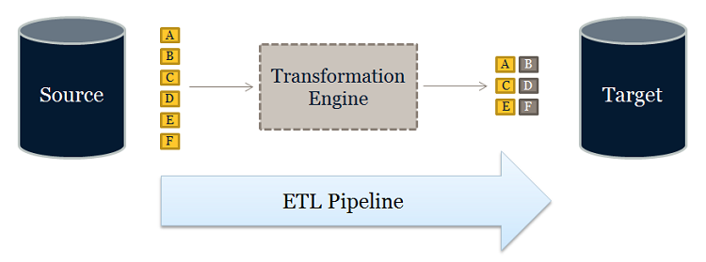
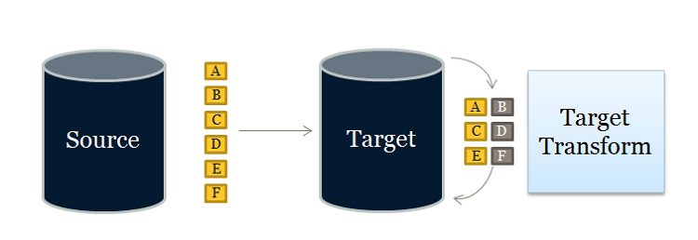
Definición de ETL y ELT
ETL
ELT

Slide 11
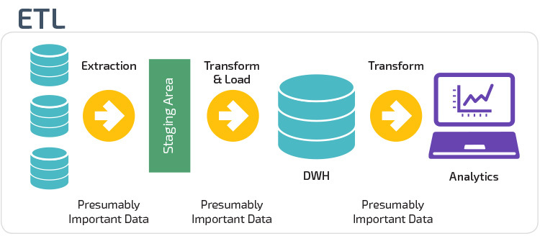
ETL Flow
Notes:
During Extraction, the desired data is identified and extracted from many different sources, including database systems and applications. Very often, it is not possible to identify the specific subset of interest; therefore more data than necessary has to be extracted, so the identification of the relevant data will be done at a later point in time. After extracting data, it has to be physically transported to an intermediate system for further processing.
Depending on the chosen way of transportation, some transformations can be done during this process, too. For example, a SQL statement which directly accesses a remote target through a gateway can concatenate two columns as part of the SELECT statement. Based on the requirements, some transformations may take place during the Transformation and Execution Phase. Through Informatica mappings, the necessary changes and updates of the data are made using transformations.
El Area de Data Integration nos permite integrar toda la logica y sistemas con
el staging area.
EL ODS (Operational Data Store) es un almacen de datos de información
operacional. La informacion en el ODS se almacena por periódos muy cortos
de tiempo ya que a medida que pasa el tiempo necesito menos detalles. De
necesitar detalles de la transacción se debe a que hubo un problema en
particular.
La informacion dentro del data warehouse esta levelmente desnormalizado,
por lo general se dimensiona mas en los Data Marts (Stages intermedios con
informacion destinada para un cierto fin, por ejemplo Informacion de Ventas)
No es algo que se puede vender, sino que esta construido en base a cada
negocio. Existen tecnologias que soportan el Data Warehouse, pero depende
de cada caso como se debe implementar.

Slide 12
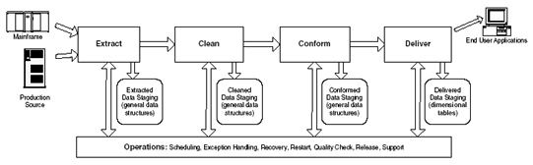
Steps
Notes:
Tool-Based ETL Advantages
A quote from an ETL tool vendor: "The goal of a valuable tool is not to make trivial problems mundane, but to make impossible problems possible."
Simpler, faster, cheaper development. The tool cost will make up for itself in projects large enough or sophisticated enough.
Technical people with broad business skills who are otherwise not professional programmers can use ETL tools effectively.
Many ETL tools have integrated metadata repositories that can synchronize metadata from source systems, target databases, and other BI tools.
Most ETL tools automatically generate metadata at every step of the process and enforce a consistent metadata-driven methodology that all developers must follow.
Most ETL tools have a comprehensive built-in scheduler aiding in documentation, ease of creation, and management change. The ETL tool should handle all of the complex dependency and error handling that might be required if things go wrong.
The metadata repository of most ETL tools can automatically produce data lineage (looking backward) and data dependency analysis (looking forward).
ETL tools have connectors prebuilt for most source and target systems. At a more technical level, ETL tools should be able to handle all sorts of complex data type conversions.
ETL tools typically offer in-line encryption and compression capabilities.
Most ETL tools deliver good performance even for very large data sets. Consider a tool if your ETL data volume is very large or if it will be in a couple of years.
An ETL tool can often manage complex load-balancing scenarios across servers, avoiding server deadlock.
Most ETL tools will perform an automatic change-impact analysis for downstream processes and applications that are affected by a proposed schema change.
An ETL-tool approach can be augmented with selected processing modules hand coded in an underlying programming language. For example, a custom CRC (cyclic redundancy checksum) algorithm could be introduced into an ETL vendor's data flow if the vendor-supplied module did not have the right statistical performance. Or a custom seasonalization algorithm could be programmed as part of a data-quality step to determine if an observed value is reasonable.
Hand-Coded ETL Advantages
Automated unit testing tools are available in a hand-coded system but not with a tool-based approach. For example, the JUnit library (www.junit.org) is a highly regarded and well-supported tool for unit testing Java programs. There are similar packages for other languages. You can also use a scripting language, such as Tcl or Python, to set up test data, run an ETL process, and verify the results. Automating the testing process through one of these methods will significantly improve the productivity of your QA staff and the quality of your deliverables.
Object-oriented programming techniques help you make all your transformations consistent for error reporting, validation, and metadata updates.
You can more directly manage metadata in hand-coded systems, although at the same time you must create all your own metadata interfaces.
A brief requirements analysis of an ETL system quickly points you toward file-based processing, not database-stored procedures. File-based processes are more direct. They're simply coded, easily tested, and well understood.
Existing legacy routines should probably be left as-is.
In-house programmers may be available.
A tool-based approach will limit you to the tool vendor's abilities and their unique scripting language. But you can develop a hand-coded system in a common and well-known language. (In fairness, all the ETL tools allow escapes to standard programming languages in isolated modules.)
Hand-coded ETL provides unlimited flexibility, if that is indeed what you need. You can literally do anything you want. In many instances, a unique approach or a different language can provide a big advantage.

Slide 13
Comparación de ETL y ELT
 | ETL | ELT
Fuentes | Parte de la información | Toda la información
Modo de transferencia | Batch / Mini Batch | Batch / Mini Batch / Streams
Cleansing | Previo a la carga | Luego de la carga
Master Data and Standarization | Previo a la carga | Luego de la carga
Performance | Limitada a la herramienta | Potenciada por el DBMS (In-DB)
Desarrollo | Guiado por interfaz | SQL u otro lenguaje de programación

Slide 14
Y con Big Data?
El rol del Data Engineer

Slide 15
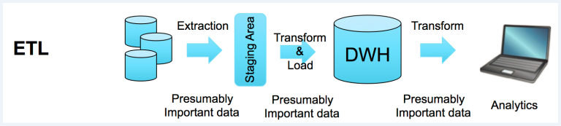
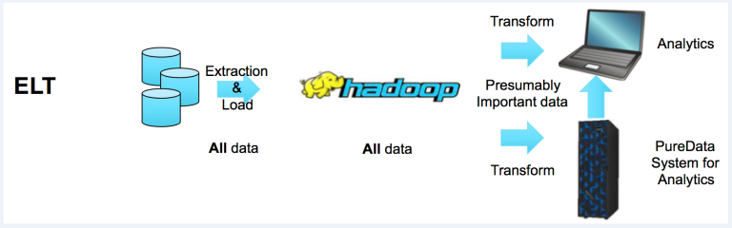
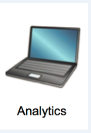
ETL/ELT en el contexto de Big Data

Slide 16
Data Engineer
El encargado de asegurarse de definir e implementar un flujo de datos desde su origen hasta su explotación de una forma controlada y automatizada
El profesional enfocado en el diseño, desarrollo y mantenimiento de los sistemas de procesamiento de datos dentro de un proyecto big data
En el proceso de tratamiento avanzado de datos, los data scientists entrenan modelos que extraen conocimiento sobre el problema a tratar a partir de los datos usando herramientas matemáticas y conocimientos del dominio de negocio

Slide 17
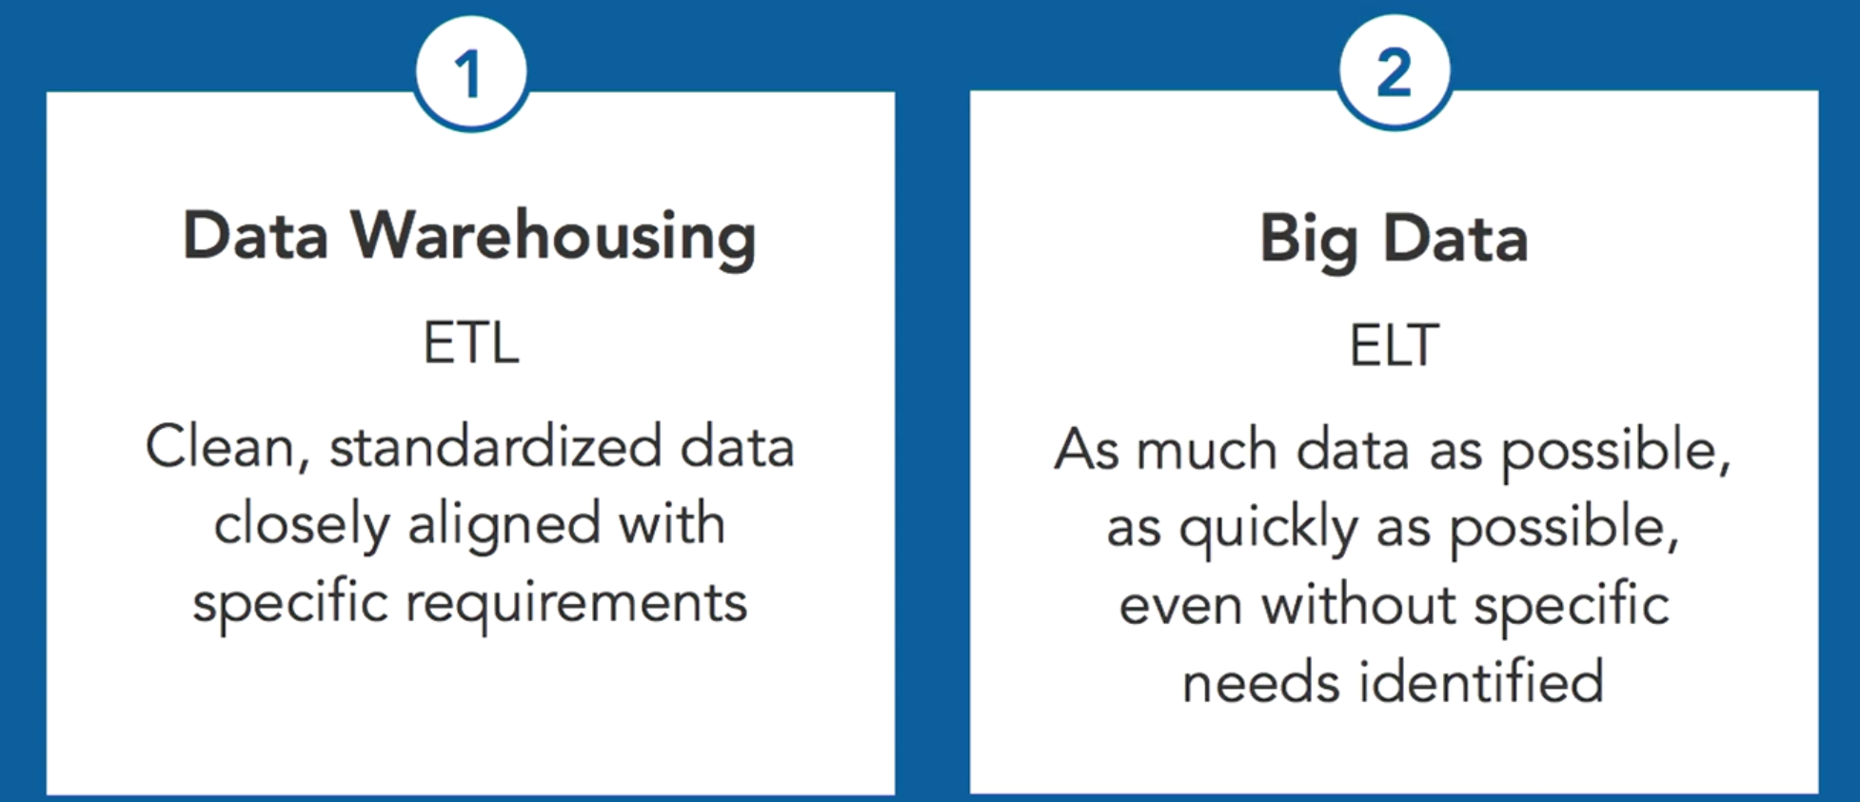
ETL/ELT en el contexto de Big Data

Slide 18
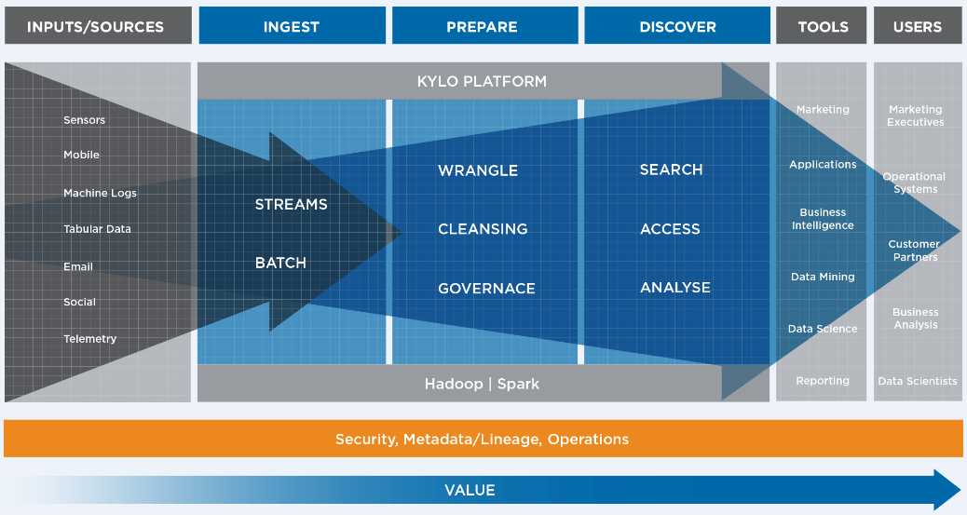

Slide 19


Data Pipeline
Una manera más general de referirnos al ETL
Cualquier flujo de información desde un origen a los Sistemas analíticos
El conjunto de pasos y aplicaciones que se ejecutan para enviar los datos desde el origen al destino
Puede incluir elementos en forma Batch o Streaming (Real Time)
Batch (lotes)
Streaming (continuo)

Slide 20
Ejercicio (Versión Notebook)
Realizar la carga de datos desde una fuente (SQL, CSV, JSON) - Utilizar este documento cómo referencia (LINK)
Realizar una transformación básica de datos mediante el uso de librerías cómo Numpy y Pandas
Almacenar los datos en una base de datos SQL o NoSQL
Notes:
Install Pymongo en Anaconda
https://anaconda.org/anaconda/pymongo
conda install -c anaconda pymongo

Slide 21
Ejercicio (Talend)
Descarga Talend (LINK)
Descarga los siguientes archivos
Country Codes
Country Vaccination
Ejecutar MySQL utilizando el contenedor Docker: docker run --name mysql -p 3306:3306 -v ~/Downloads/MySQL:/var/lib/mysql -e MYSQL_ROOT_PASSWORD=UADE2021 -d mysql
Crear base de datos (ETL) - Puedes utilizar el nombre que desees
Crear Tabla (covid) - Puedes utilizar el nombre que desees
Nota: Talend requiere Java 8, por lo qué sí te encuentras en versión superior, deben descargar versión 8 y realizar el cambio de variables de entorno correspondiente

Slide 22
